Slide 1
Spatial dynamics
UCAR

Slide 2
What drives changes in ecosystem processes over space?

Slide 3
Spatial dynamics: Land use and land cover change (LULCC)

Slide 4
LULCC
Change from one land type to another
Largest ongoing global change

Slide 5
Extensification
An increase in the area affected by human activities
Deforestation in Vietnam
Bourgoin et al. (2019) IJ App. Earth Obs. and Geoinformation

Slide 6
Tilman et al. (1999) PNAS

Slide 7
Intensification
Increase in resource use for new land use

Slide 8
Tilman et al. (1999) PNAS

Slide 9
Spatial dynamics: Eco-climatic teleconnections

Slide 10
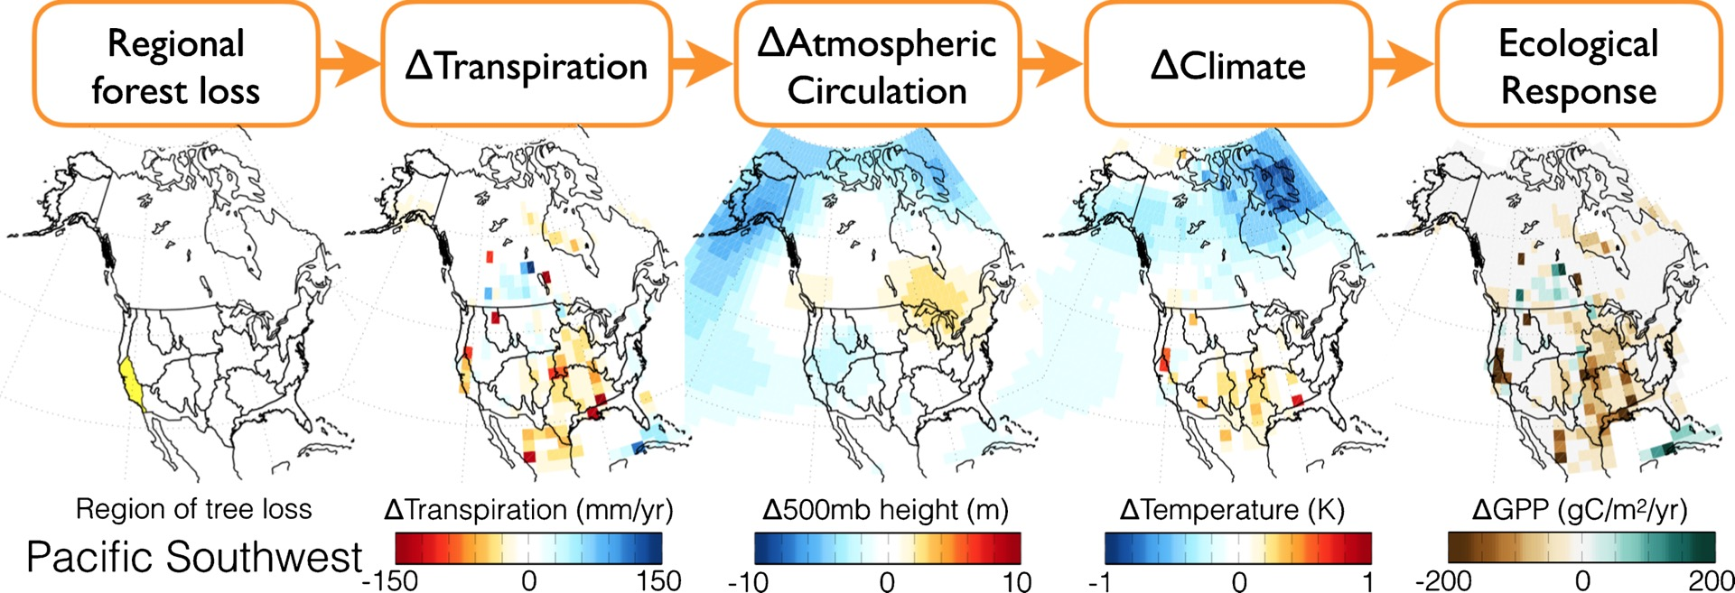
Swann et al. (2018) Env. Res. Let.

Slide 11
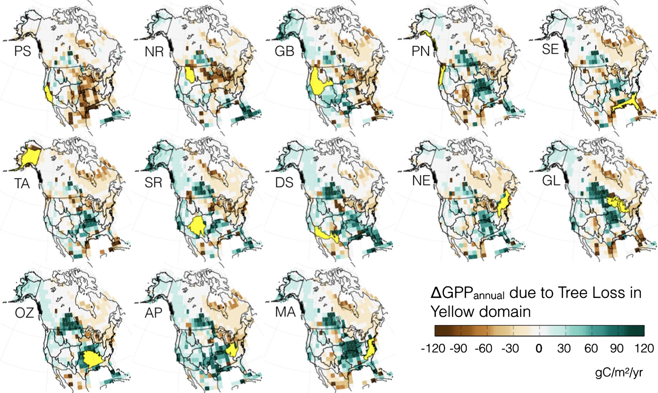
Swann et al. (2018) Env. Res. Let.

Slide 12
Spatial dynamics: coordinated research networks

Slide 13
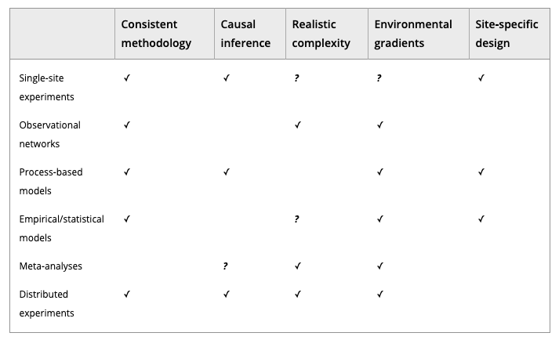
Borer et al. (2013) Meth. Ecol. Evo.

Slide 14
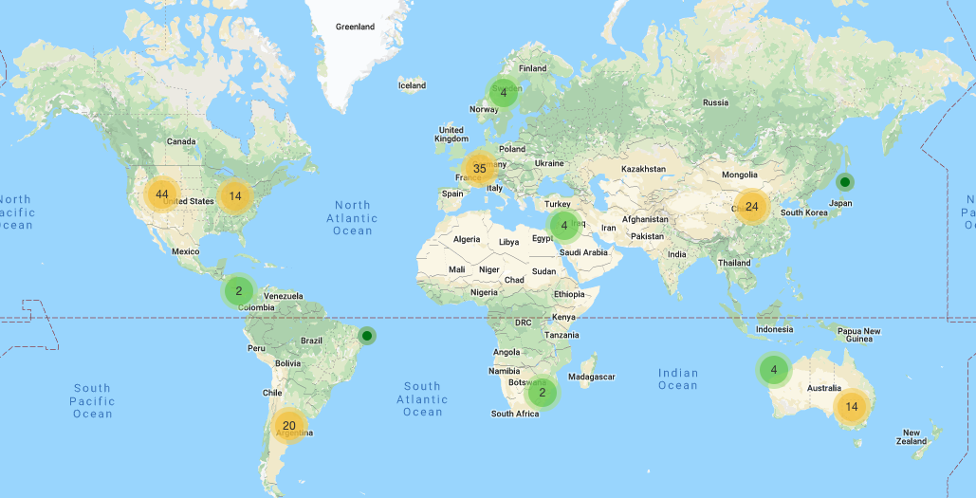
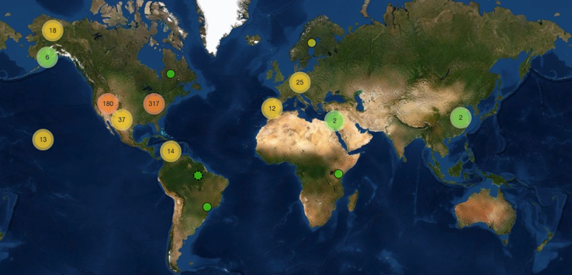
PhenoCam
Network

Slide 15
The National Ecological Observatory Network (NEON)

Slide 16

The National Ecological Observatory Network (NEON)
BioScience (October 2019)

Slide 17
How do we predict spatio-temporal changes in ecosystem processes?

Slide 18
Land surface models
UCAR

Slide 19
Earth System Models
Dr. Kaitlin Naughten

